Slide 1
Sprint 1: Planning
PSec (Portable Security)
Group 4

Slide 2

Table of contents
01
02
03
04
Introduction
Requirements
Planning
Q&A

Slide 3

!!
330.085
cases of reported burglary in The Netherlands (2020 CBS)

Slide 4
01
Introduction

Slide 5
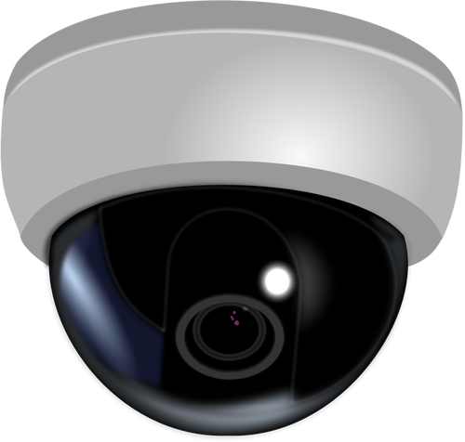
What is PSec?
Portable CCTV
Features:
Motion detection
Sound detection
Security alert notification
Live Stream

Slide 6

What is PSec?
Web Application
Camera
Allows to see the monitored space as live stream. Possibly group and pass-protect individual spaces so nobody has access to video/audio of it.
The camera will record and stream video to the web application.
In the future it could also have object or facial recognition.

Slide 7
02
Requirements

Slide 8

Functional requirements
Camera
Web app
Motion sensor
To monitor spaces and live stream
To access live stream and alert files
To detect motion within the monitored spaces
Sound detection
SQL database
Intruder Alarm
To detect sounds within the monitored space
To save account details and captured files
To alert users in case of a break-in

Slide 9
Non-functional requirements
Accessibility
Live stream is online at least 90% of the time
Quality
Availability
720p video
The live stream is available from anywhere

Slide 10
Security requirements
User authentication
Keypad authentication
To login on the web app the user needs to login
The keypad is used in the room to pause the security system
Password encryption
Datastream encryption
The passwords stored in the database needs to be encrypted
The data stream from the camera to the web app also needs to be encrypted

Slide 11
03
Planning

Slide 12
Sprints planning
Sprint 2 | Sprint 3 | Sprint 4
Create UML diagrams and design prototype, etc. | Implement account authorization | Testing and bug fixing
Setup WEB and SQL servers | Save alerts as photos/texts in webapp | Work on COULD features
Build and setup camera | Implement opportunity to restrict the access to certain files | Improve UX/UI
Implement motion/sound detection | Enable Livestream | Improve synchronization
Send text alerts | Create UI | Optimize code

Slide 13
Sprint 2: Design
Work on designing the project:
UML diagrams
MOSCOW-model
Create product and web app design prototype
Start programming part:
Motion/sound detection
Text alert notifications

Slide 14
04
Q&A

